Slide 1

TASK 3
CROSS SITE SCRIPTING (XSS)

Slide 2
MANUAL TYPING

Slide 3
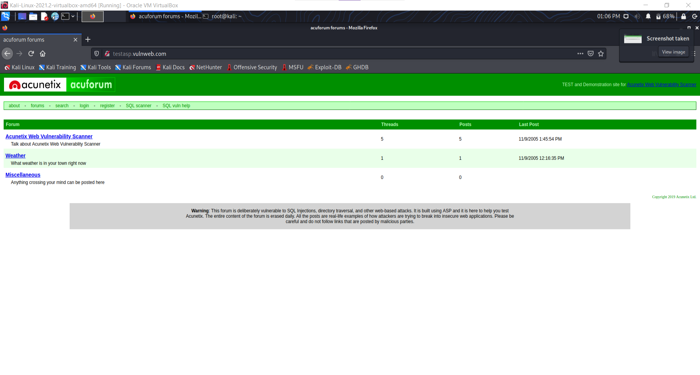
SCREENSHOT-1

Slide 4
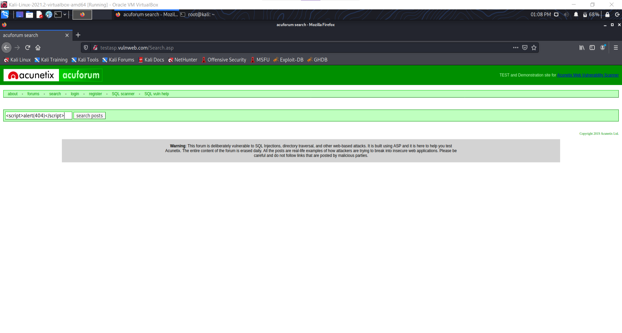
SCREENSHOT-2

Slide 5
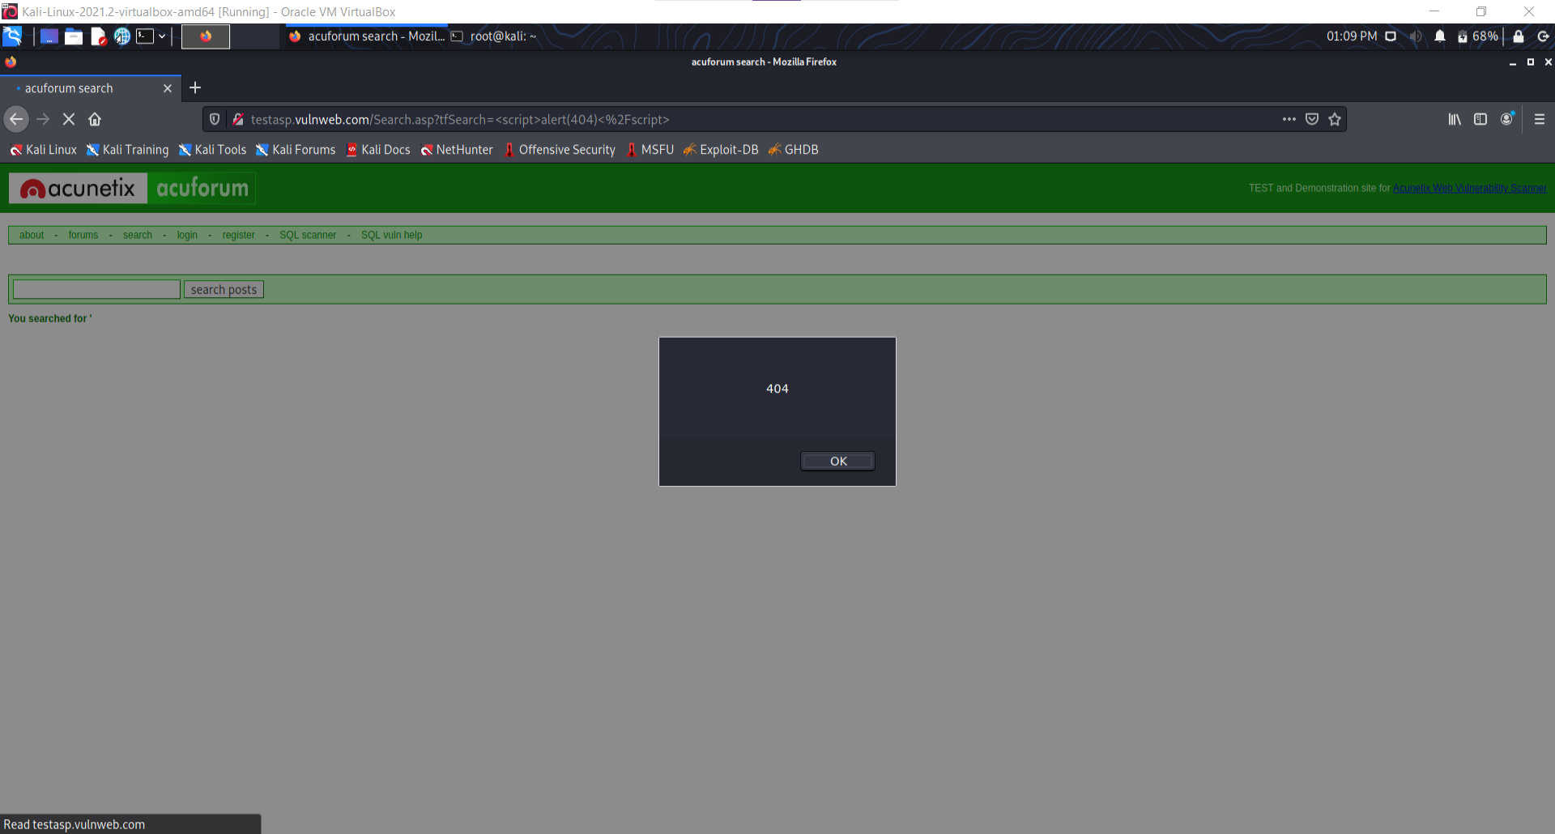
SCREENSHOT-3

Slide 6
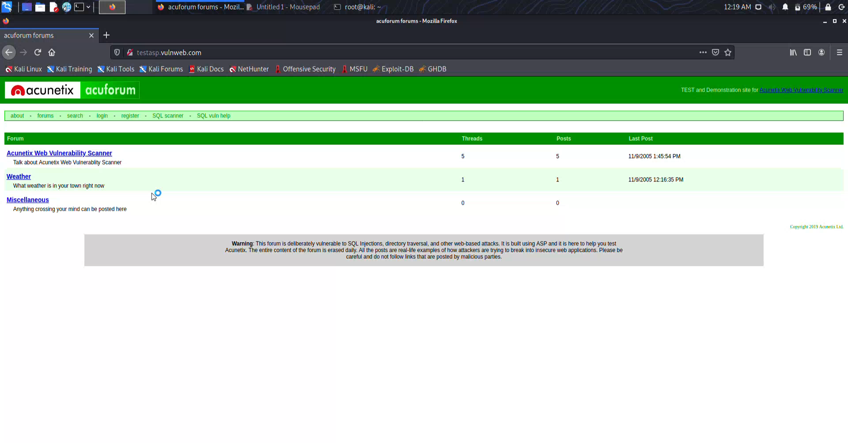
POC VIDEO

Slide 7
REPORT-1
Title: Cross Site Scripting (XSS)
Domain: vulweb.com
Subdomain: testasp.vulnweb.com
**
**
Steps to reproduce:
Step 1: Visit http://testasp.vulnweb.com/
Step 2: On the top menu you will find a search option.
Step 3: Click on it and you will be prompted with the Search box.
Step 4: Try to find a successful payload for XSS.
Step 5: Prepare a report for it.
**
**

Slide 8
REPORT-2
Impacts:
1. It helps us to detect XSS weaknesses before malicious hackers do. XSS continues to remain a major threat to such web applications. This could help hackers to steal user's personal information and exploit it.
2. A list of all the XSS payloads which can attack the website are showed in an orderly manner.
3. This can help us to prepare for future upgrades on the sub-domain.
4. It serves as an established security record for later assessments.
Mitigation:
1. If the vulnerabilities are noticed beforehand, we can lessen the likelihood and/or impact of a vulnerability being exploited.
2. This is sometimes necessary when a proper fix or patch isn't yet available for an identified vulnerability.
3. This option should ideally be used to buy time for an organization to eventually remediate a vulnerability.
4. Here, Sanitize user input: Validate to catch potentially malicious user-provided input.
5. Also we can encode output to prevent potentially malicious user-provided data from triggering automatic load-and-execute behavior by a browser
Including:
1. Screenshots
2. POC

Slide 9
BURPSUITE

Slide 10
SCREENSHOT-1

Slide 11
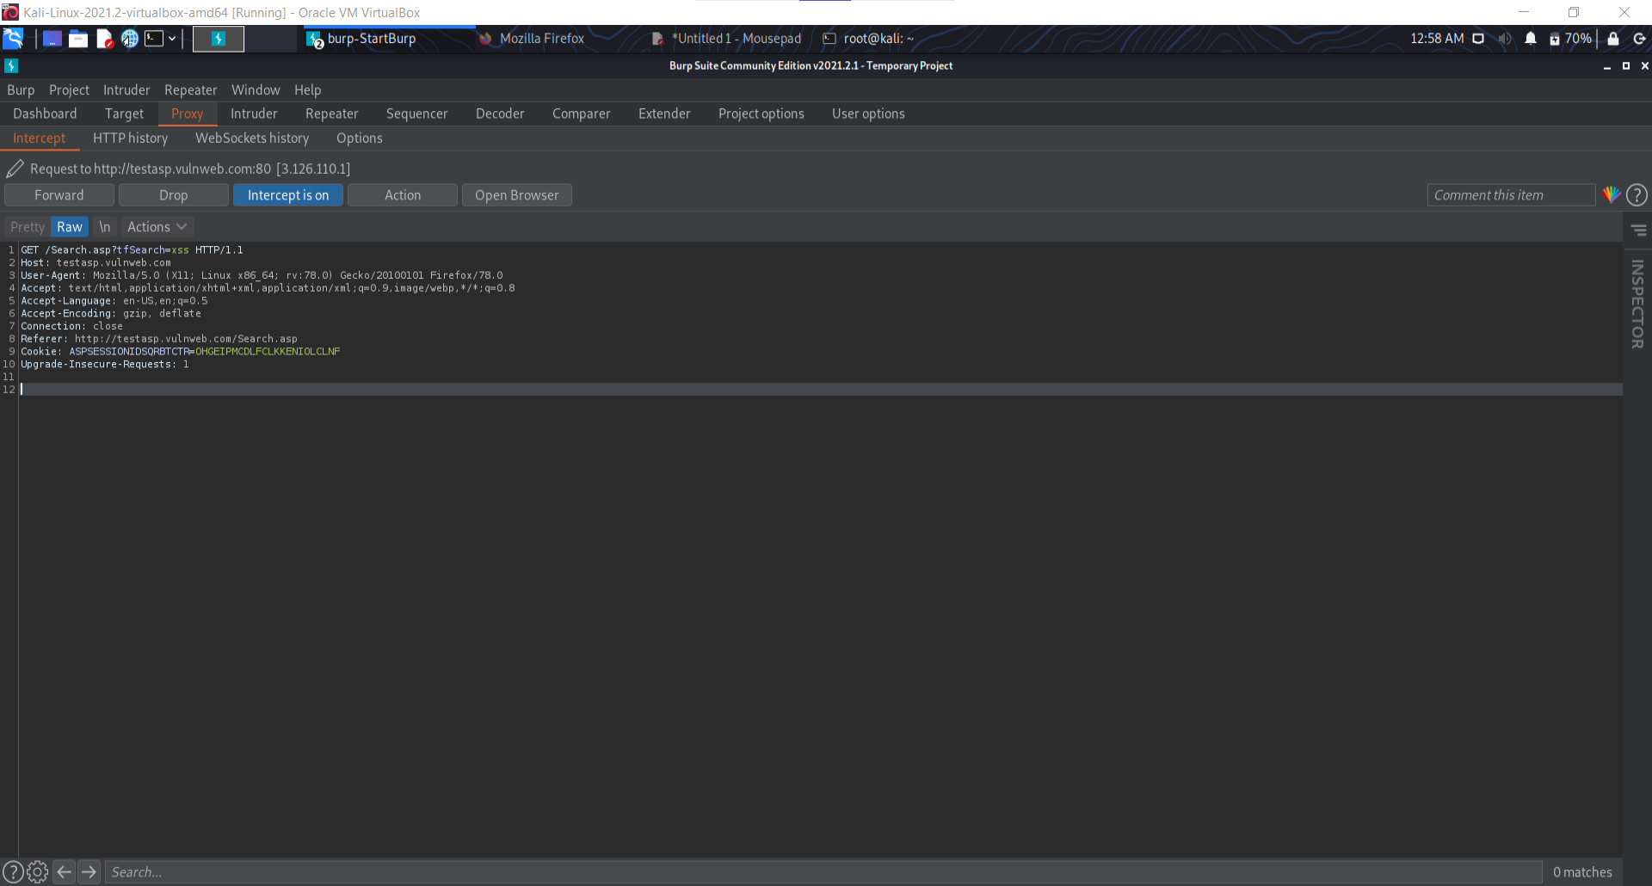
SCREENSHOT-2

Slide 12
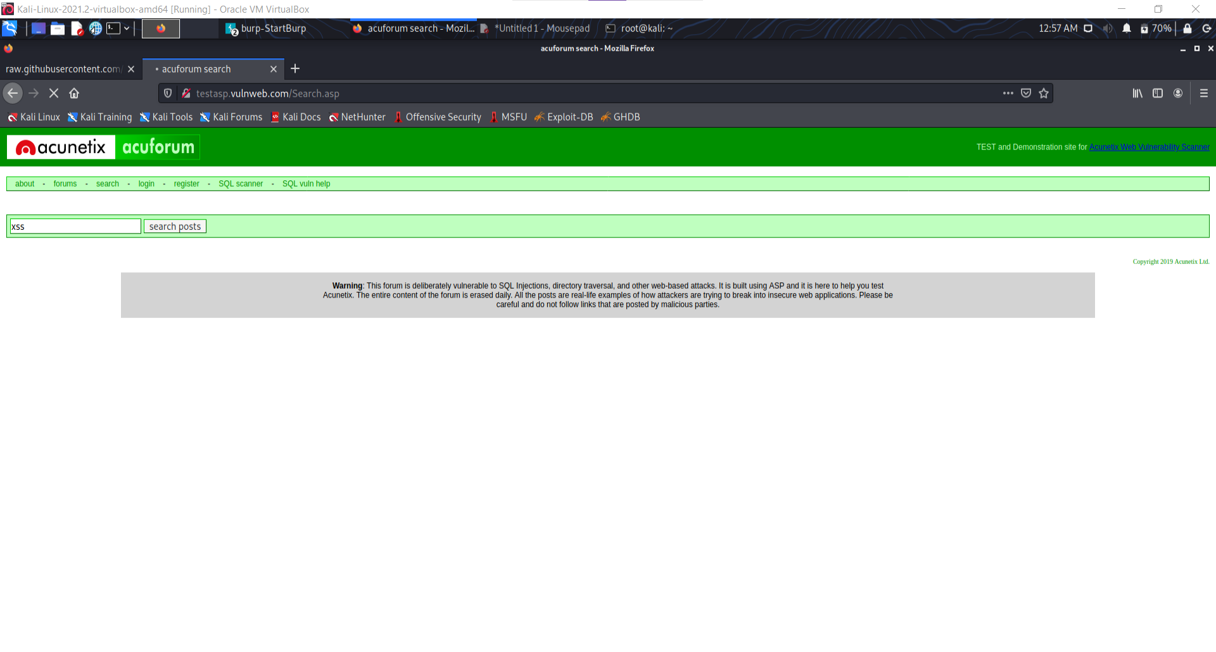
SCREENSHOT-3

Slide 13
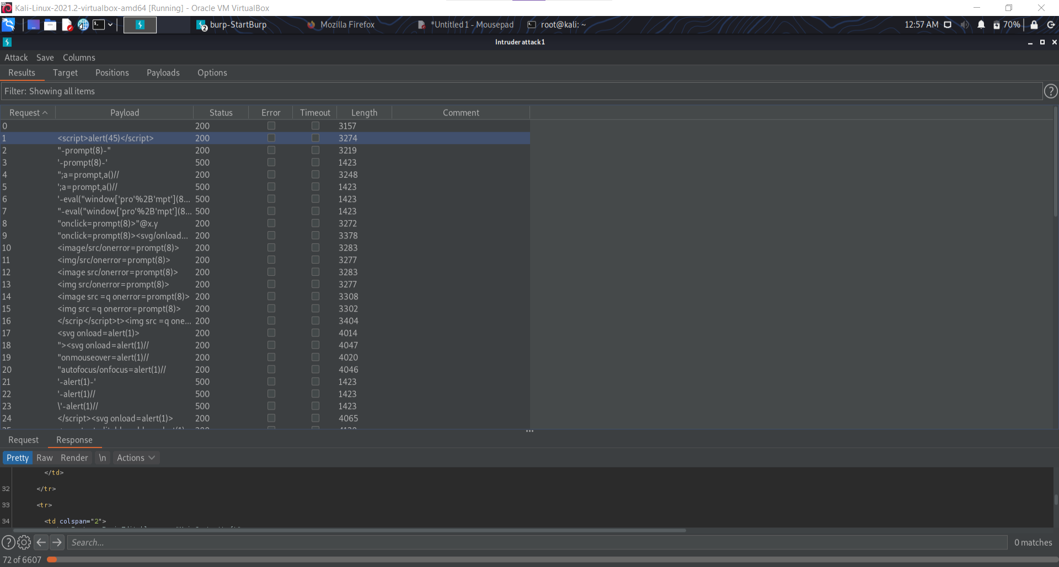
SCREENSHOT-4

Slide 14
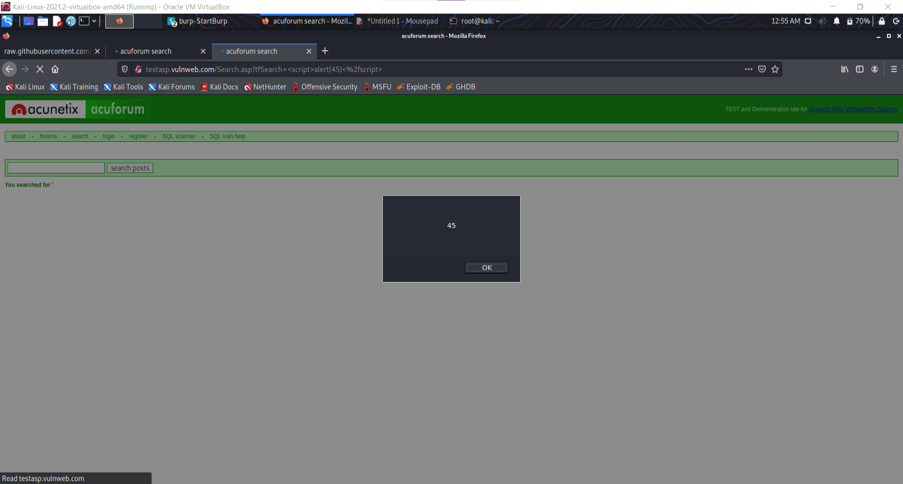
SCREENSHOT-5

Slide 15
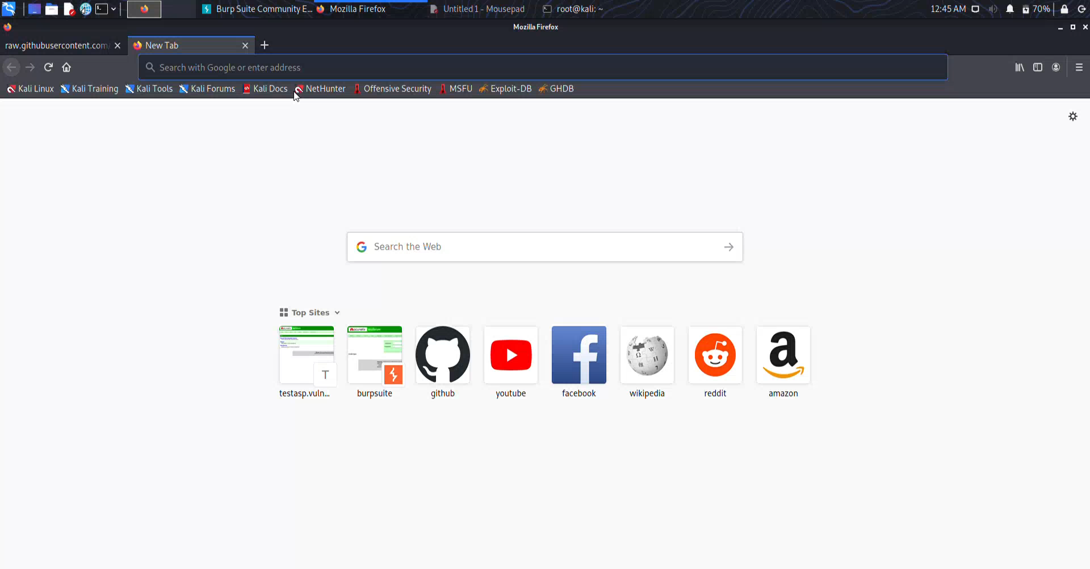
POC VIDEO

Slide 16
REPORT-1
Title: Cross Site Scripting (XSS)
Domain: vulweb.com
Subdomain: testasp.vulnweb.com
Steps to reproduce:
Step 1: Visit http://testasp.vulnweb.com/
Step 2: On the top menu you will find a search option.
Step 3: Click on it and you will be prompted with the Search box.
Step 4: You can intercept the request in Burp Suite
Step 5: Now you can find different payloads for XSS.
Step 6: Send the request to the intruder and paste all the payloads.
Step 7: Try to find a successful payload for XSS.
Step 8: Prepare a report for it.

Slide 17
REPORT-2
Impacts:
1. It helps us to detect XSS weaknesses before malicious hackers do. XSS continues to remain a major threat to such web applications. This could help hackers to steal user's personal information and exploit it.
2. A list of all the XSS payloads which can attack the website are showed in an orderly manner.
3. This can help us to prepare for future upgrades on the sub-domain.
4. It serves as an established security record for later assessments.
Mitigation:
1. If the vulnerabilities are noticed beforehand, we can lessen the likelihood and/or impact of a vulnerability being exploited.
2. This is sometimes necessary when a proper fix or patch isn't yet available for an identified vulnerability.
3. This option should ideally be used to buy time for an organization to eventually remediate a vulnerability.
4. Here, Sanitize user input: Validate to catch potentially malicious user-provided input.
5. Also we can encode output to prevent potentially malicious user-provided data from triggering automatic load-and-execute behavior by a browser
Including:
1. Screenshots
2. POC

